Slide 1
Sketching with Hardware
10: Interaction Design

Slide 2
What is Interaction Design?
Part of User Experience Design
Introduced by Bill Moggridge and Bill Verplank in the mid 80s
Design of Human-Computer Interfaces
Overlaps with User Interface Design
Difference: The result of Interaction Design is not always a User Interface

Slide 3
Five Pillars of Interaction Design
Defined by Moggridge, extended by Gilliam Campton-Smith and Kevin Silver:
Words
Visual Representation
Physical Objects and Space
Time
Behavior

Slide 4
What does this mean?
User-Centered approach (can’t be done in the scope of this course due to time constraints)
Connection to cognitive pyschology:
Mental Models
Inteface Metaphors
Affordances
→ “The Design of Everyday Things” (Norman, 1988)

Slide 5
Affordances
„The affordances of the environment are what it offers the animal, what it provides or furnishes, either for good or ill.“
- James J. Gibson, 1979
„Affordance is what the environment offers the individual.“
- Wikipedia

Slide 6

Live Demo...
https://commons.wikimedia.org/wiki/File:USAF_EOD_explosion.jpg

Slide 7
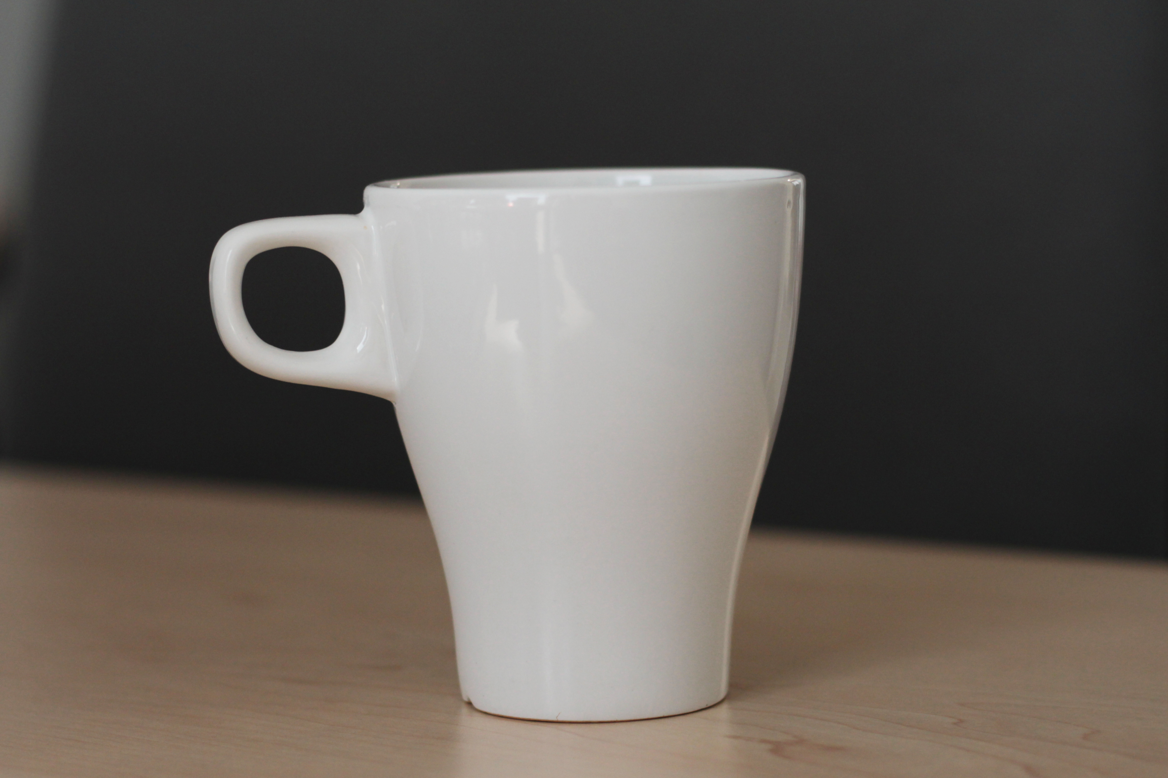

Slide 8
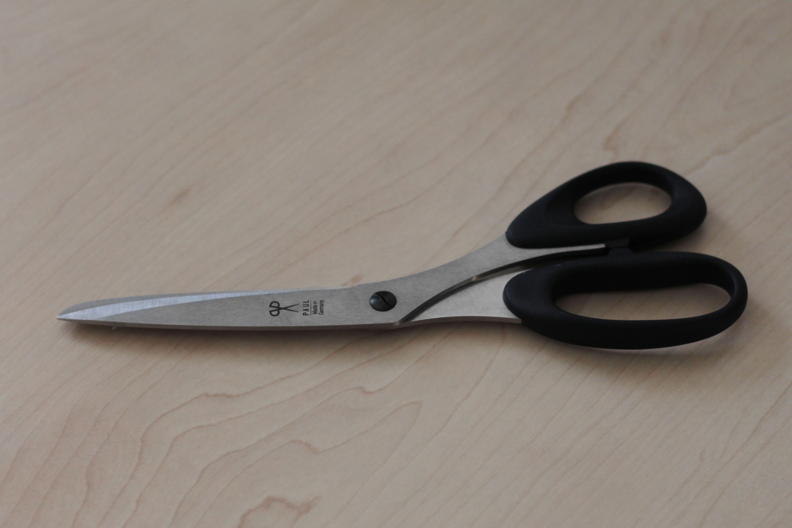

Slide 9
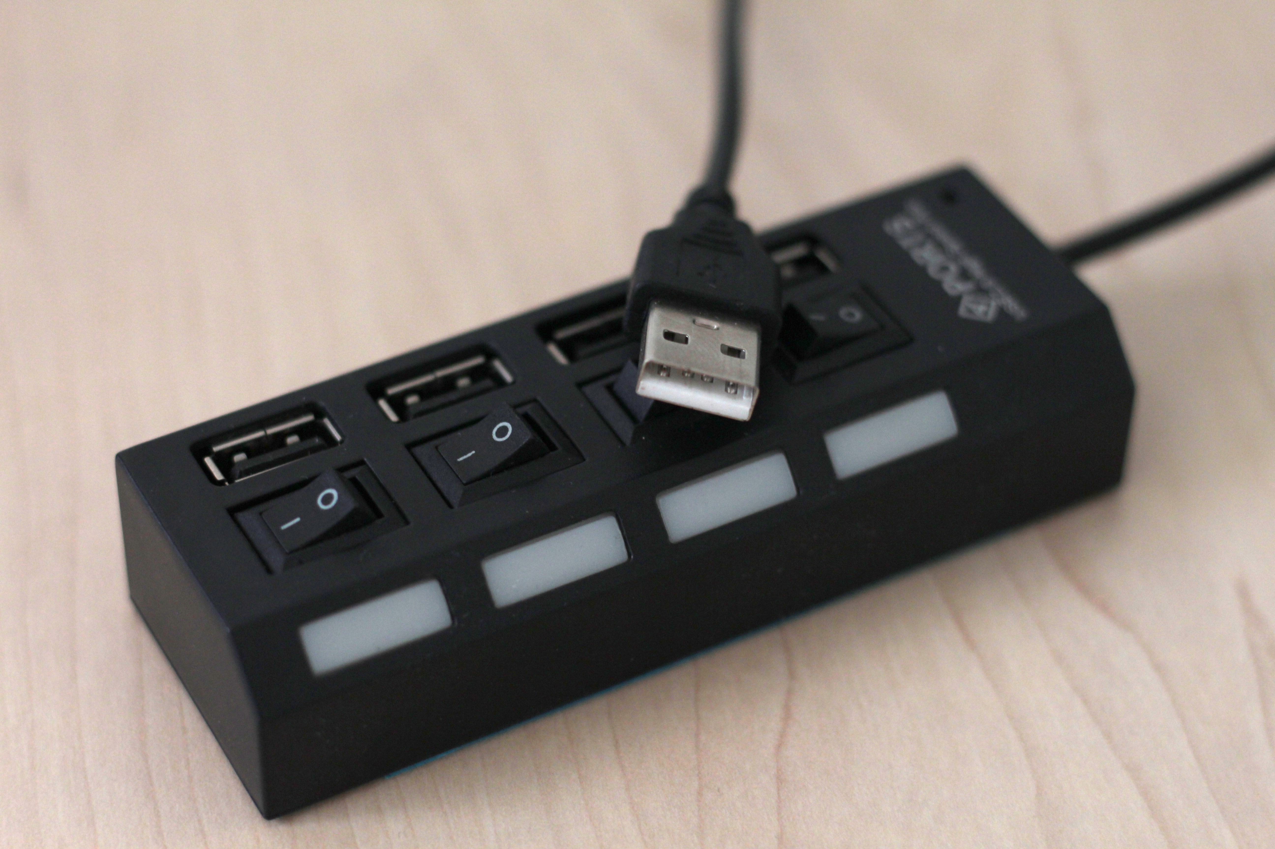

Slide 10
Designing Tangible UIs
Physical objects offer different affordances than GUIs:
Three dimensional
Tangible
Physical properties (size, weight, …)
Collaboration between users is easy
Affordances should be obvious
Ideally, TUIs should work without a GUI/display
Haptic feedback is possible

Slide 11
Project Demos

